Slide 1
Wayward Navigation Rover
Austin Booth, Jacob Freeman, Andre Mbakwe, Garrett Shoemaker, Wesley Dodgen, Aaron Hoffman
Notes:
RECORD MEETING!

Slide 2
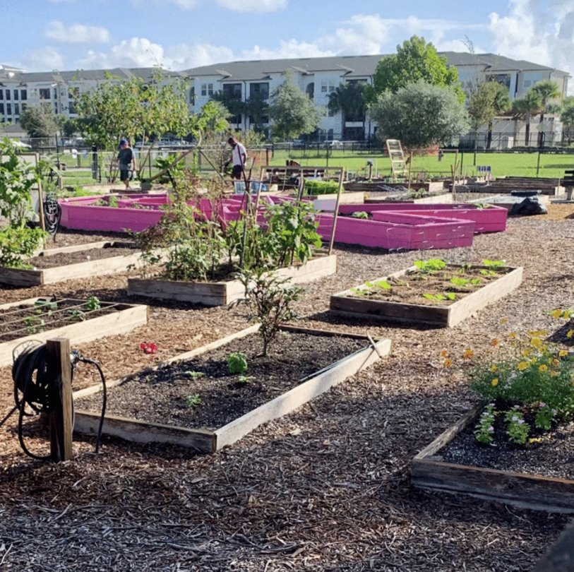
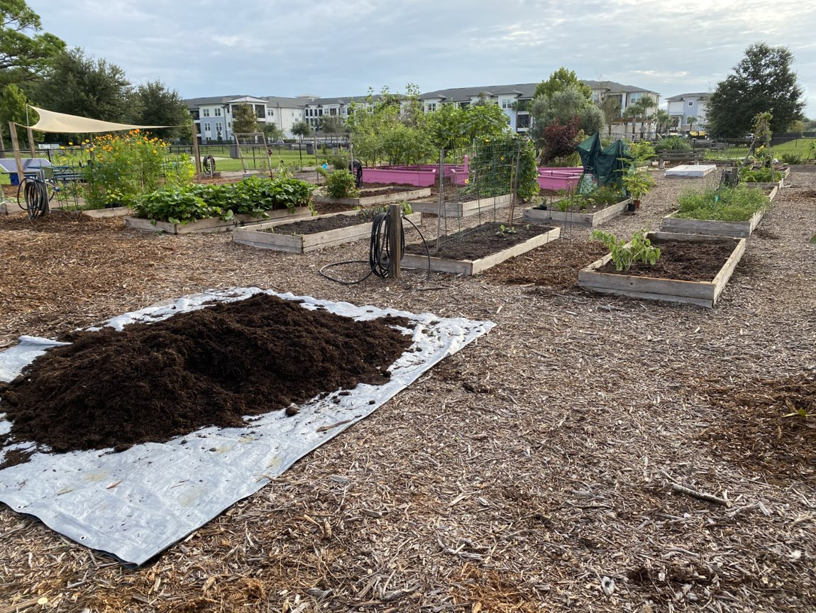
Background Information
Tasked to create a mobile robot platform to navigate through a garden
Navigate remotely via cloud and mobile device
Easy assembly requested (can be built with a kit/at home supplies)
Design will be open source when completed

Slide 3
Milestones Achieved
Created a platform that supports expansion
Coded an I/O interface to allow users easy access to the robots mobility
Constructed robot frame from 3D printed parts and PVC piping purchased locally
Project will be placed on GitHub for open source release after completion
Notes:
Fill out google form sent out earlier today!

Slide 4
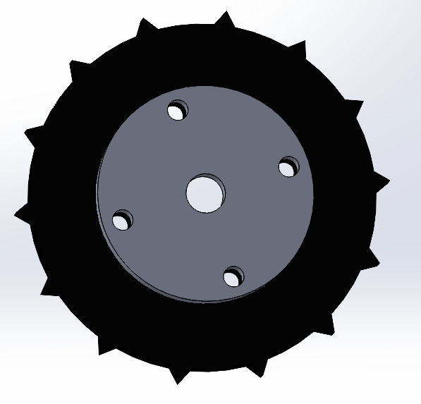
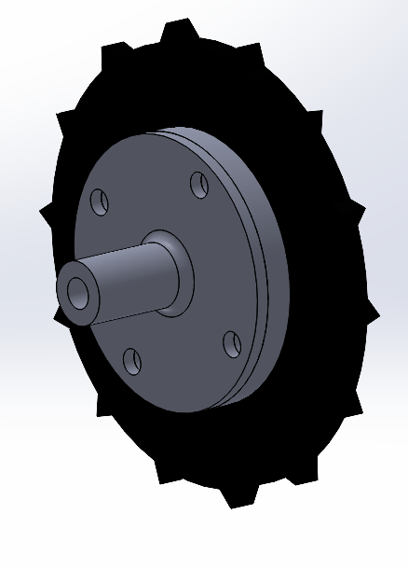
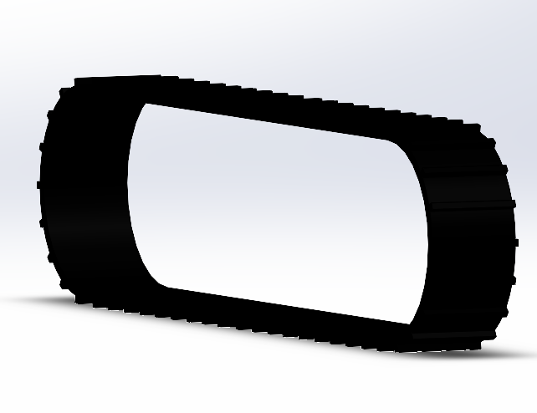
Traction and Drive Gear:
Driven wheel on tensioner
Meshed reinforcement for longevity
Driving/Driven Sprockets:
Drive Flange attaches to sprocket across 4 bolts
SuperDroids Robots Tread

Slide 5
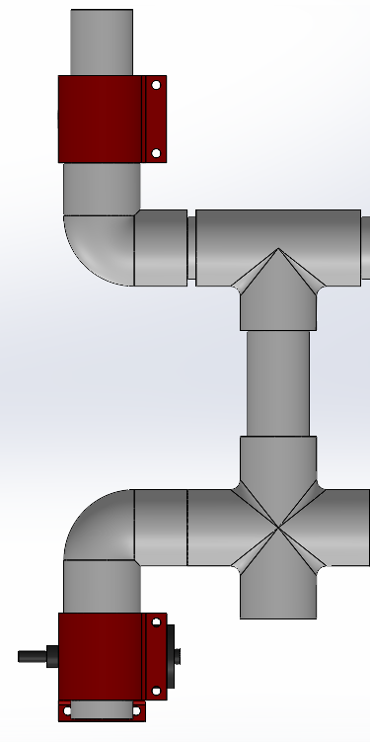
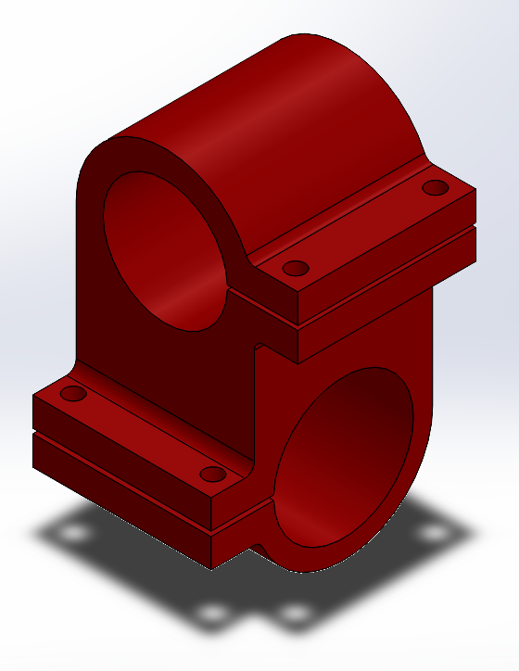
Tensioning System:
Adjustable tension along PVC
PVC Clamp
Bolt Locations for applying clamping force
Motor clamp in fixed position
Motor Clamp
PVC to Motor Clamp:
Tensioning System:

Slide 6
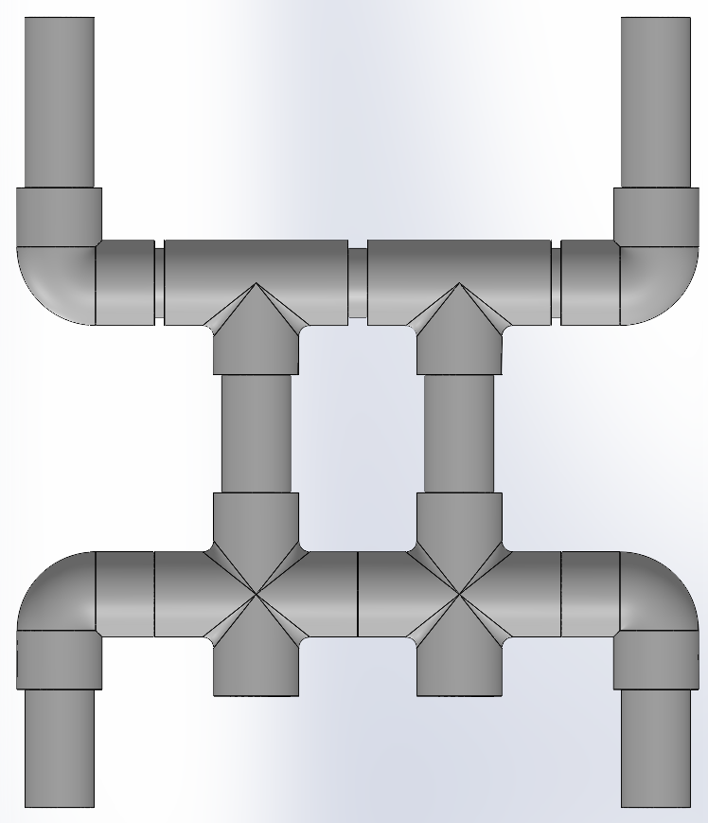
Chassis Design and Structure:
All components held in place by PVC adhesive
Outer structure attachment points for suspension system
Boxed Center section for Rigidity
Main Frame Structure:

Slide 7
Chassis Expansion:
Why a PVC Design?
Modular
Interchangeable Parts
Expandable
Cheap and easily accessible
Open Joints for easy addition of components

Slide 8
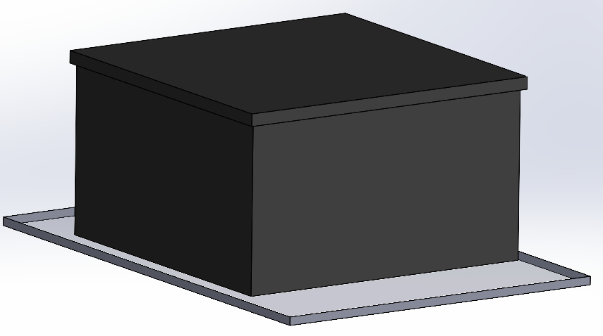
Electronics Housing:
Weatherproof Conduit Box for housing all support electronics
Clear Acryllic base plate for added rigidity and mounting surface for electronics housing
Base Plate and Electronics Housing:

Slide 9
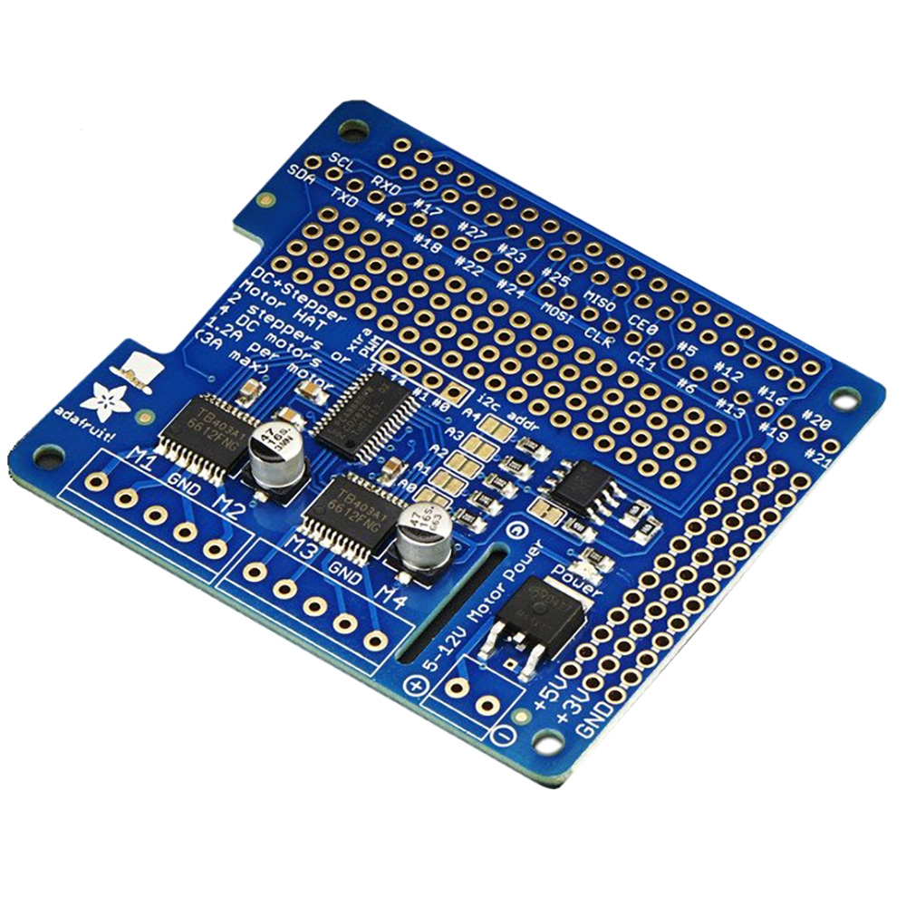
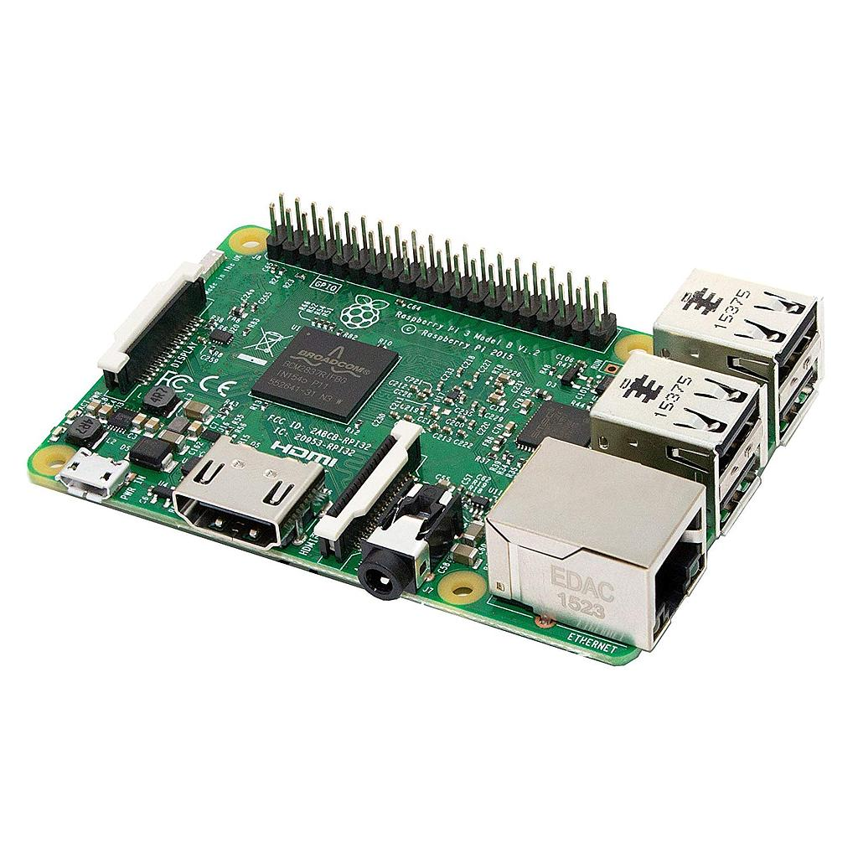
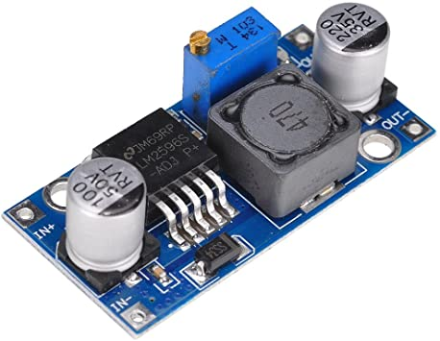
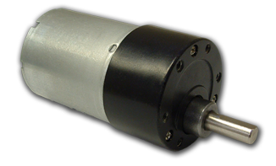
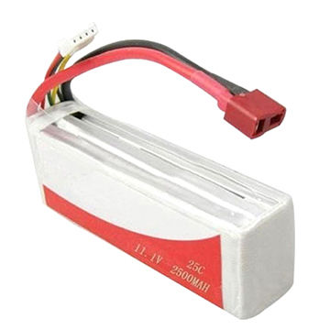
Electrical Components
Raspberry Pi
5V input power from buck converter
Adafruit Motor Hat
Controls up to 4 brushed motors
Stackable for future expansion
DC Motors
Brushed
12V, 0.5A
Regulated Buck Converter
Set at 5V to power Raspberry Pi
12V LiPo Battery
Powers motors and Pi in parallel
Power Switch

Slide 10
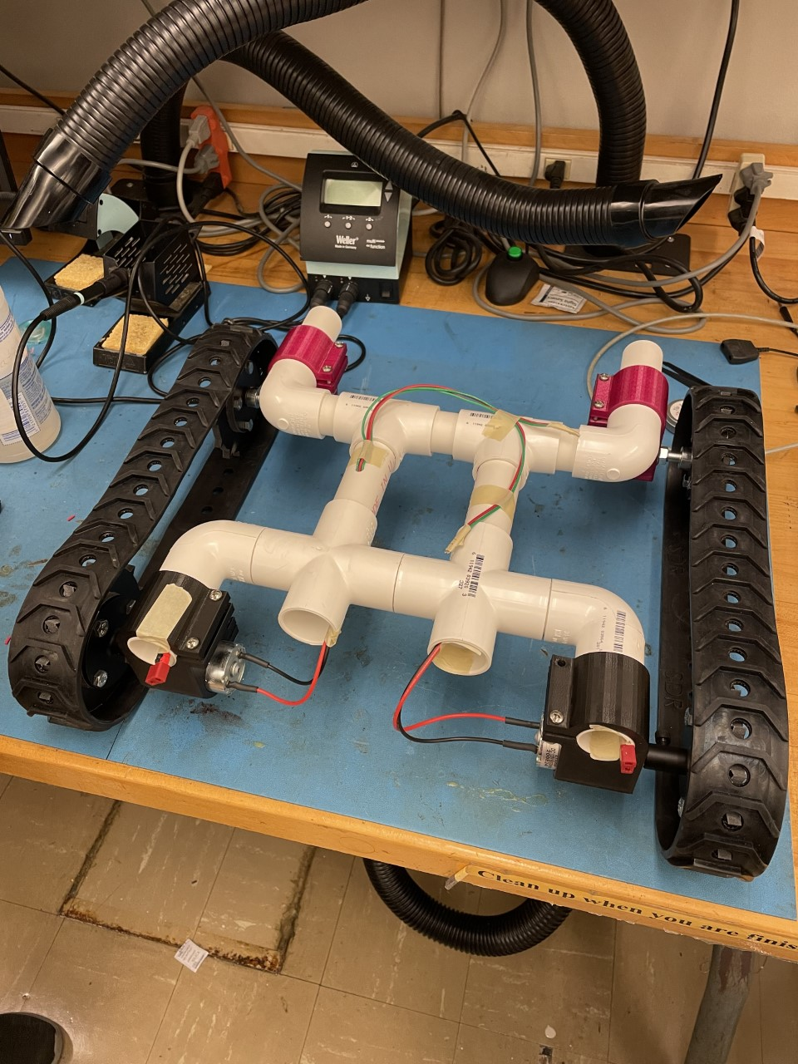
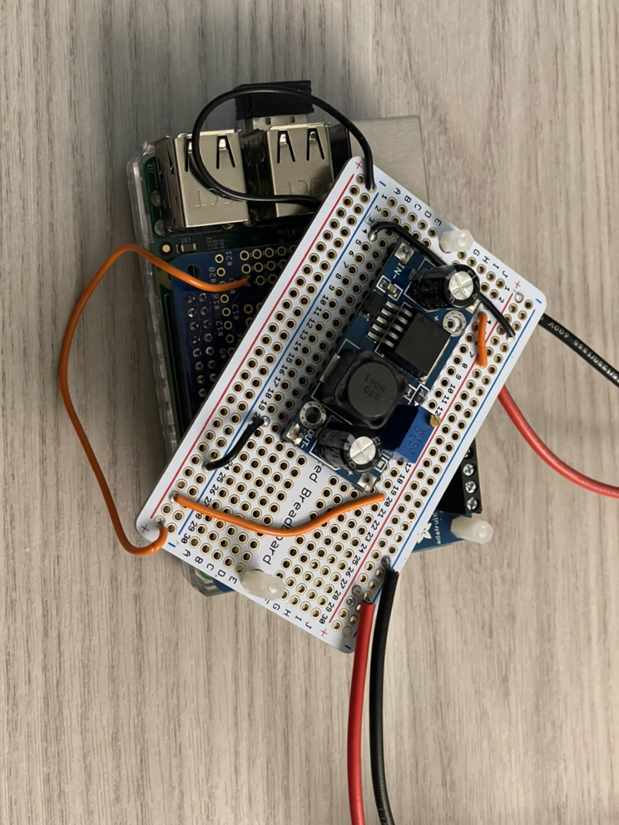
Electrical Assembly
Wires routed through the frame for weather resistance
Boards stacked and mounted to optimize space inside electrical housing

Slide 11
Software
MQTT
A low over-overhead way to send and receive messages
It takes up very little space for devices and very bandwidth when messages are sent back and forth

Slide 13
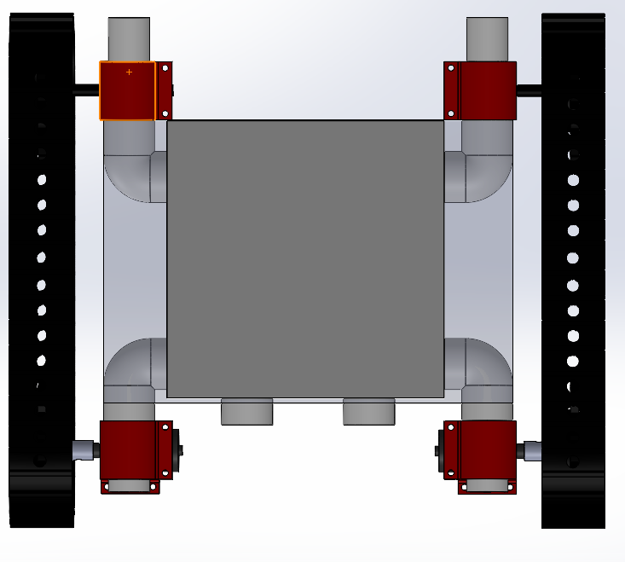
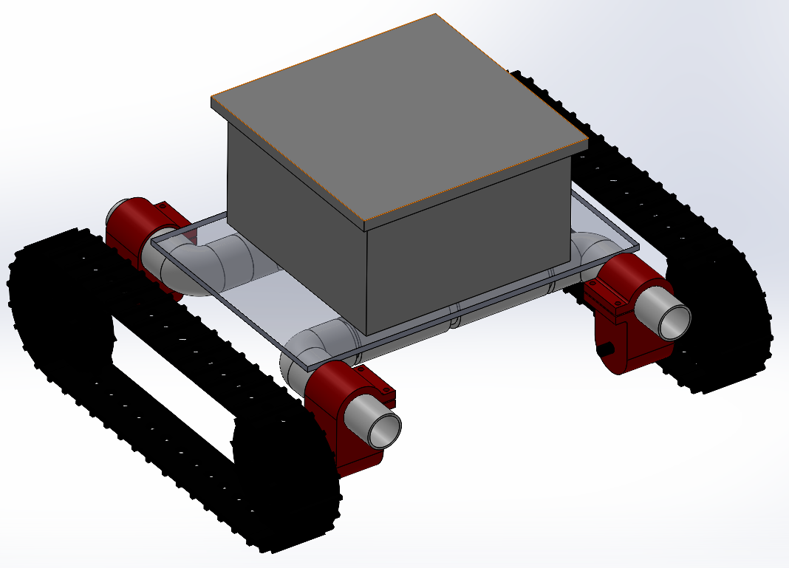
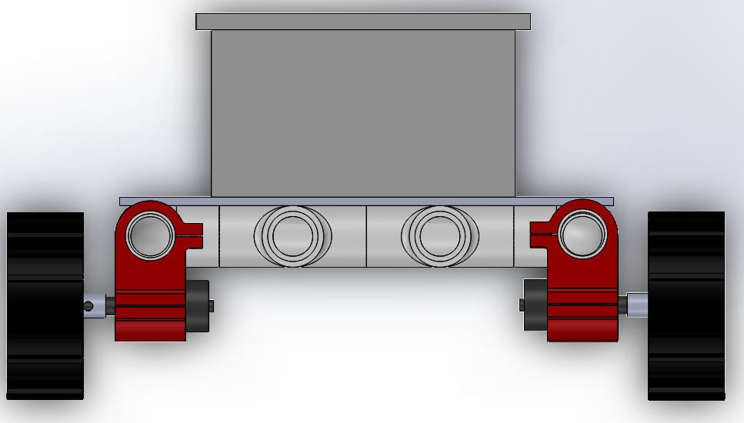
Final Result:
Top:
Isometric:
Front:

Slide 14
Future Improvements:
Incorporate camera for remote navigation
Add a solar battery charger for increased autonomy
Update suspension system to dual sprocket drive gears
Expand robot chassis to support peripheral mounting
Add additional protection against the weather/outdoors
Upgrade motors in order to tackle more obstacles

Slide 15
Questions?

